Slide 1

Computer Animation
Lab 4 - A1 Forward Kinematics
COMP 477

Slide 2
Background
What is forward kinematics?
How is it useful?
How is it used in games?
Let’s take a look at where it fits in a game pipeline...

Slide 3
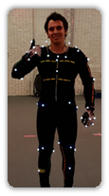
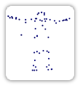
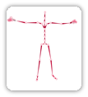
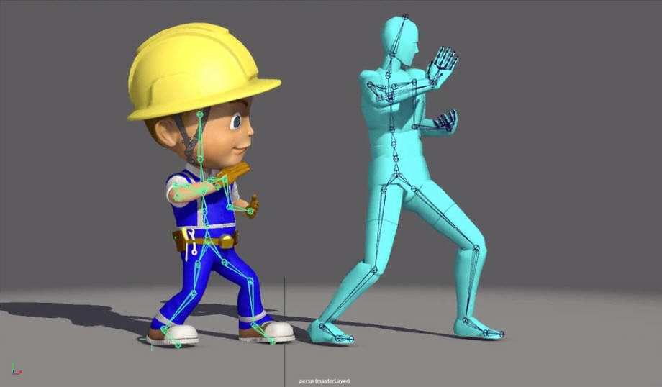
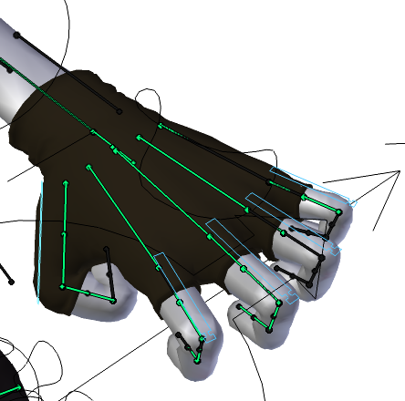
Game Animation Pipeline
Computer Animation pipelines vary drastically by studio. Typically for a AAA game, the pipeline will resemble the following:
Preprocessing
MOCAP
Cleanup
Solving
Retargeting
Rigging + Skinning
Delivery
FBX
BVH

Slide 4
Game Animation Pipeline
Delivery
The result of the pipeline is a character animation file stored a standardized format (FBX, BVH, etc.) Formats vary, but typically we store need the following information:
Skeletal Structure:
“At-rest” joint lengths
“Pre-rotations”
Hierarchical Information (parent indices)
Skinning Information:
Vertex-joint correspondances (typically max 4 joints per vertex)
Skinning weights
Animation Information
Per-frame joint rotations
Per-frame joint translations
Usually only the root

Slide 5
Game Animation Pipeline
In-Engine
Animation
File
Animation Database
FK
Animation
Fine-tuning
Skinning
Rendering
FBX
BVH
Blend Tree
Motion Matching
Generate Global Positions
Simple IK
Collisions
LBS
DQS
On GPU

Slide 6
Assignment 1: Intro
θ₂
Goal:
Implement Forward Kinematics
Instructions:
https://moodle.concordia.ca/moodle/pluginfile.php/5155229/mod_resource/content/0/A1.pdf
Github:
https://github.com/tiperiu/COMP477_A1
θ₁

Slide 7
Assignment 1: Implementation
Essentially, you’ll need to write an “FK” function, which:
Takes in:
Local Joint Rotations, Joint Lengths
Spits out:
Global Joint Positions
The course “Forward Kinematics” slides will be useful for this assignment

Slide 8
Assignment 1: Expected Behavior
Once in “Showtime” mode, the user can drag individual joints. Two different behaviors are expected:
If the root joint(joint with no parents) is dragged, the whole structure moves rigidly as follows:

Slide 9
Assignment 1: Expected Behavior
Once in “Showtime” mode, the user can drag individual joints. Two different behaviors are expected:
If the any other joint is dragged, it, along with all the joints “under” it, rotate around the joint’s parent

Slide 10
Assignment 1: Expected Behavior
Once in “Showtime” mode, the user can drag individual joints. Two different behaviors are expected:
If the any other joint is dragged, it, along with all the joints “under” it, rotate around the joint’s parent
θ

Slide 11
Assignment 1: Expected Behavior
Once in “Showtime” mode, the user can drag individual joints. Two different behaviors are expected:
If the any other joint is dragged, it, along with all the joints “under” it, rotate around the joint’s parent
θ

Slide 12
Assignment 1: Expected Behavior
Once in “Showtime” mode, the user can drag individual joints. Two different behaviors are expected:
If the any other joint is dragged, it, along with all the joints “under” it, rotate around the joint’s parent

Slide 13
Assignment 1: Expected Behavior
Note that you don’t need to worry about the case where a joint has multiple parents (and subsequently, the case where a hierarchy has multiple roots)

Slide 14
Further Reading
Useful blog post covering FK in Unity:
https://www.alanzucconi.com/2017/04/06/implementing-forward-kinematics/

